Slide 1
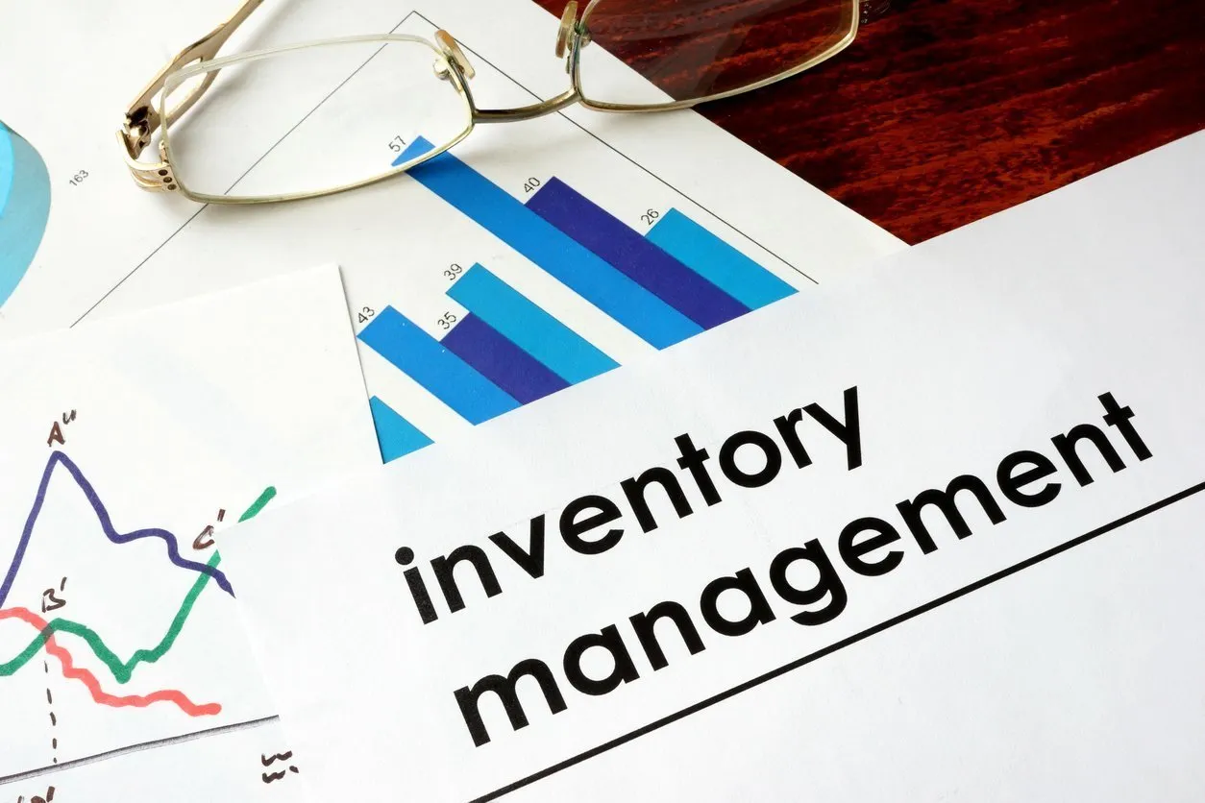
Online Inventory Management System
UNDER THE GUIDANCE OF - MRS.L.PRIYANKA
SUBMITTED BY –
CH.VIJAY KUMAR (20W91A0541)
G.SRIKANTH (21W95A0506)
CH.PUJITHA (20W91A0534)

Slide 2
ABSTRACT:
Products are considered as the business resources for the organization. This includes managing the product with an appropriate way to review at any time as per the requirement. Therefore it is important to have a computer-based IMS that can generate reports, maintain the balance of the stock, details about the purchases and sales in the organization these applications are only used by large organizations so we came up with an application that can be used by the small company for the management of their stock. After analyzing the other inventory management system we decided to include some of the common and key features that should be included in every inventory management system. So we decided to include those things that help small organizations.

Slide 3
Existing System
In the present non-computerized system all jobs are performed manually. All Customer details are written and stored in paper format in a file.
Prop maintains separate files for each new information. So managing them is very complex and has become an impossible task to be performed manually systematic way.
As the job is done manually, it has its limitations and lots of paperwork.

Slide 4
Limitation of Existing System
In present system each and every record is maintained in files, so there will be lot of redundancy in maintaining ‘Customer and Volunteer records.
Also there is no security as all records are maintained in files.
Modification of one record causes changes to other records related to that record, so work becomes very critical, there are chances of data loss

Slide 5
The Proposed System
The proposed system is computerized and has been developed using advance language therefore it gives more facilities than the present system.
It provides quick access to any data.
Features of the project include aspects such as making my software user-friendly i.e. to make it so easy to use that the user will not dream of switching back to the original System.

Slide 6
Advantages of Proposed System
The system is platform independent as it is developed in PYTHON with DJANGO Web Application.
It facilitates quick processing of data.
Data present in database is highly secured.
Searching of data is done very easily & more efficiently.

Slide 7
HARDWARE REQUIREMENTS:
System : I3.
Hard Disk : 40 GB.
Ram : 4 GB.

Slide 8
SOFTWARE REQUIREMENTS:
Operating system : Windows 8.
Coding Language : Python.
Framework : Django
Front-End : HTML, CSS,JAVASCRIPT.
Data Base : My SQL.

Slide 9
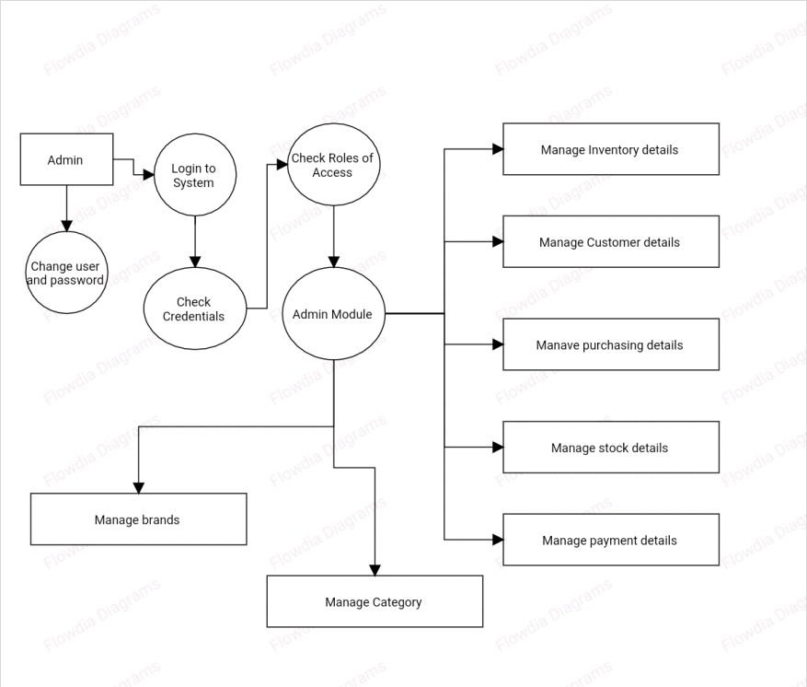
SYSTEM ARCHITECTURE

Slide 10
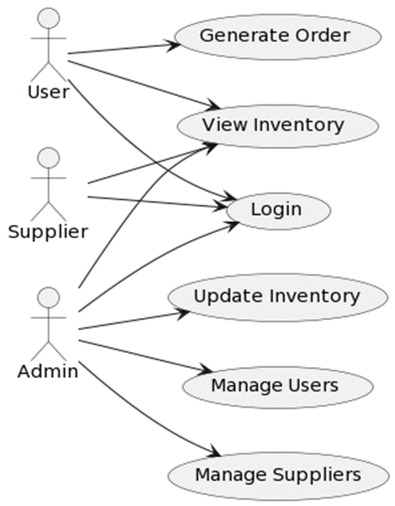
UML DIAGRAMS : 1) USE CASE DIAGRAM:

Slide 11
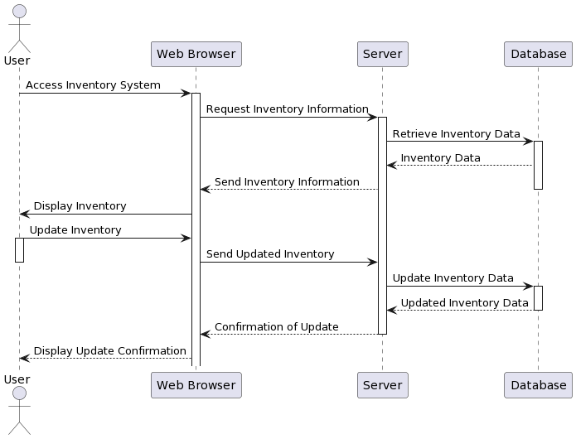
SEQUANCE DIAGRAM :

Slide 12
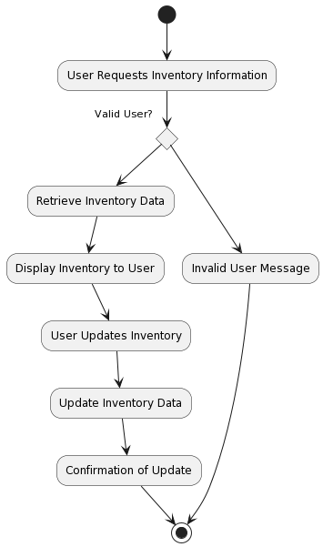
ACTIVITY DIAGRAM:

Slide 13
MODULES :
USER LOGIN:
In this project normal users can signup with the application and then browse
product list and purchase product from that list.
ADMIN LOGIN:
Admin user can login to application and then View Total transaction and
registered users. Admin can predict stock trending quantity by using Random
Forest Machine Learning algorithm for any store location. To train machine
learning algorithm we have used WALMART sales dataset.

Slide 14
IMPLEMENTATION :
User Authentication and Authorization: Make sure only the right people can access your system.
Inventory Tracking: Keep tabs on what items you have in stock and how many of each.
Search and Filter: Help users find what they're looking for quickly.
Reporting and Analytics: Show trends and insights about your inventory.
Order Management: Handle customer orders smoothly from start to finish.

Slide 15
Notifications: Send alerts for important events like low stock or new orders.
Mobile Responsiveness: Make sure your system works well on phones and tablets.
Security: Keep your data safe from hackers and unauthorized access.
Scalability and Performance: Ensure your system can handle growth without slowing down.

Slide 16
from django.shortcuts import render
from django.template import RequestContext
from django.contrib import messages
import pymysql
from django.http import HttpResponse
from django.core.files.storage import FileSystemStorage
import datetime
import pandas as pd
import numpy as np
from sklearn.metrics import mean_squared_error
from sklearn.ensemble import RandomForestRegressor
import matplotlib.pyplot as plt

Slide 17
CONCLUSION
It helps keep track of items in stock. The system makes it easier to manage inventory. It saves time by automating tasks. It's accessible from anywhere with the internet. The project reduces errors and improves accuracy. Overall, it's a helpful tool for businesses to handle their inventory efficiently.

Slide 18


